Slide 1

Welcome
Dev Fundamentals
Notes:
Mandatory
ACTION: Adjust title to fit your course.

Slide 2

Hello...
About me...
I am Indrajit with Develop Intelligence.
I am Data Enthusiast having 10+ Years of Experience in IT.
Specialized in Business Analytics & Engineering.
NLP & ML expert developer on AWS
I have a Masters degree in Data Analytics.
I love to do watercolor paintings when I am not teaching.
Indrajit Singh
Notes:
Mandatory
ACTION: Adjust to fit you.
Script: I am [insert name] with DevelopIntelligence. We’re the training partner for [insert client name]. [Provide brief info on your background.]
Wing it!!! Keep it short!!! (Under 2 minutes; less than 1 is even better). Your goal is to establish rapport. You’re just trying to connect with the students. For example...
Here’s a little about my background in case you want this for reference later. Fun fact: [insert a piece of trivia about your personal life…”When I’m not teaching or coding, I am a skydiver”…whatever cool hobby you are engaged in]
Avoid putting your resume here. Say only a sentence or two about your professional credentials and invite them to ask questions about your background or experiences at any point during the training.

Slide 3
Prerequisites
This course assumes you
Know some basics of programming in any languages.
Have never taken a formal course in Dev Fundamentals and know little or nothing about Software Development.
Please Note
If you have never programmed before that's also ok .In this course we will write some programs to demonstrate dev fundamentals.
Please send your query in chat so we can direct you towards the right resource.
Notes:
Mandatory
ACTION: Adjust prerequisites to fit your course. Keep it brief.
Script: Before we start, I want to make sure everyone is in the correct class. Take a look at these prerequisites and message me in Chat if you have questions or aren’t sure you’re in the right spot.

Slide 4
Why study this subject?
Why to take a course on Dev Fundamentals ?
Services as an entry point in the world of Software Development.
Understand how to work with Software Developers.
Notes:
Mandatory
ACTION: Adjust benefits to fit your course.
Examples...
You’ll be learning Python so that you can work on XYZ project…

Slide 5








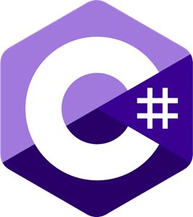







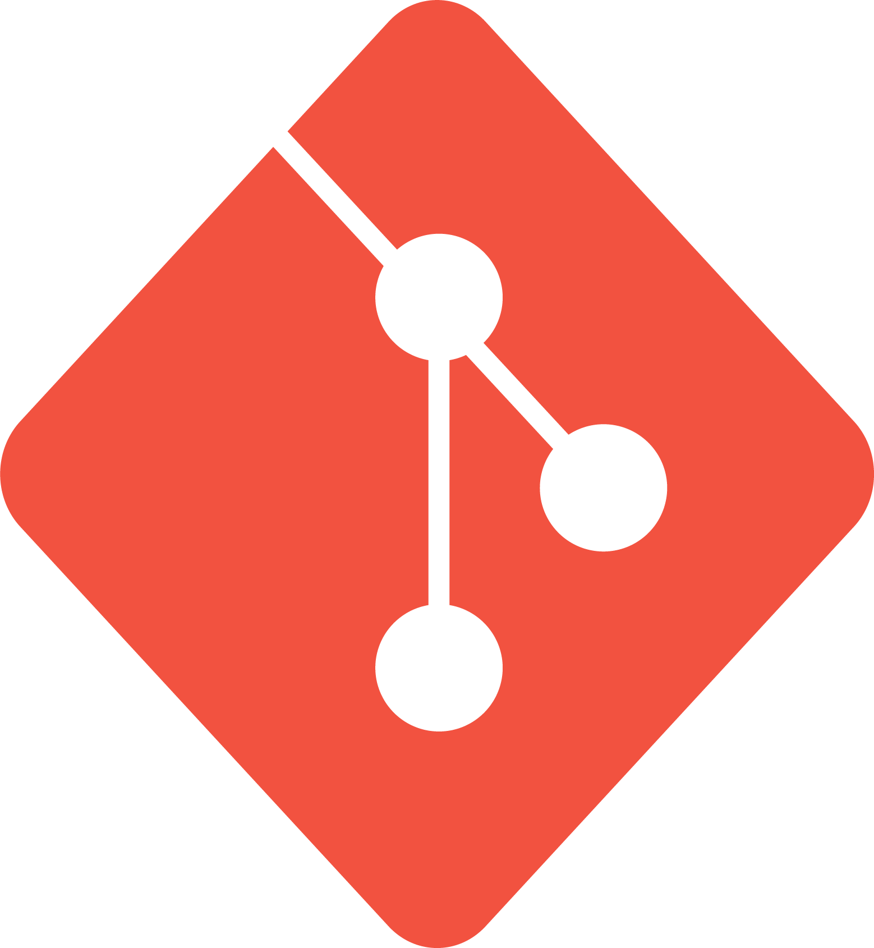
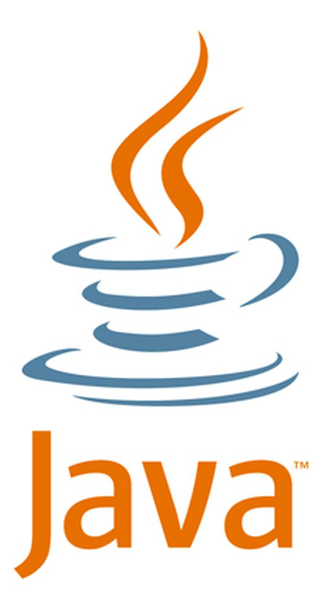






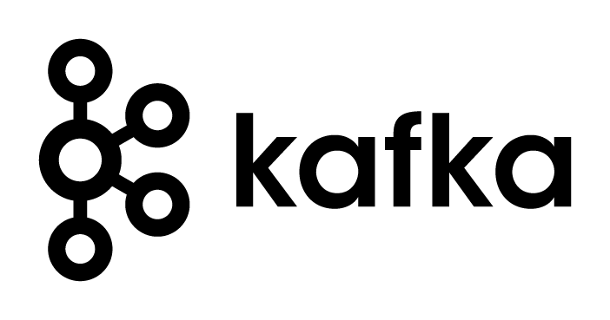







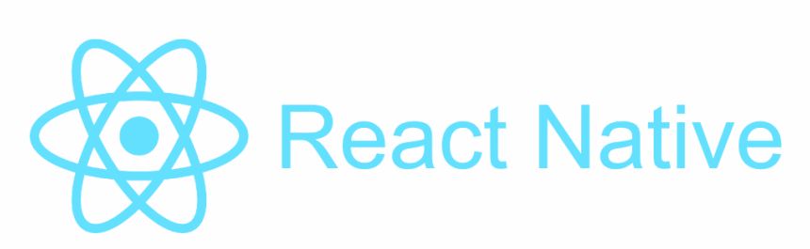
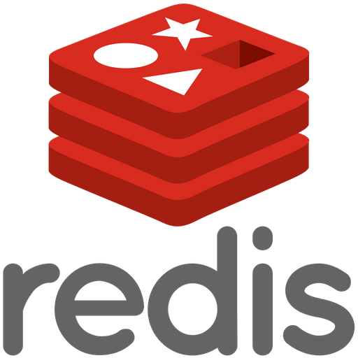




We teach over 400 technology topics
Notes:
Mandatory
Script: DevelopIntelligence teaches a lot of different tech. If there’s a technology you want to learn and you don’t see it in your company’s learning catalog, let your manager know. We’d be glad to help.”

Slide 6



You experience our impact on a daily basis!
Notes:
Mandatory
Script: In your everyday life, you come across tech many times a day. When you shop online. When you pay for your morning coffee. When you watch a movie or travel. We train software developers and IT professionals who work on many of the products and services you use daily.
In fact, when you talk on the phone, watch a movie, connect with friends on social media, drive a car, fly on a plane, shop online, and order a latte with your mobile app, you are experiencing the impact of our solutions.

Slide 7
My pledge to you
I will...
Make this interactive
Ask you questions
Ensure everyone can speak
Create an inclusive learning environment
Use an on-screen timer for breaks
…also, if you have an accessibility need, please let me know
Notes:
Mandatory
Script: This is my pledge to you. I’d like to talk in particular about the third bullet. Sometimes in a class, an enthusiastic participant will want to speak out in every discussion, answer every question and so forth. I want to make sure all of you have the opportunity to be heard. So, if I haven’t heard from you in awhile, I may call on you or check in via chat, because I want to make sure everyone gets their questions answered. Also, I want to demonstrate the timer and confirm that everyone can see it. EggTimer is a good timer - https://e.ggtimer.com/

Slide 8
Objectives
At the end of this course you will be able to:
Have hands-on experience in build, integration & deployment of code.
Clear your fundamentals on DevOps process flow.
Understand Software and Its development lifecycle.
Discuss software development process with various stakeholders and learn to document them as a Business Analyst.
Notes:
Mandatory
ACTION: Adjust objectives to fit your course.
Use measurable objectives that start with action verbs such as: describe, define, identify, assess, demonstrate, use, utilize. https://elearningindustry.com/writing-learning-objectives-for-elearning-what-elearning-professionals-should-know

Slide 9
Agenda
Understand the influences on a project
Understand what a software process is
Understand two common models
Notes:
Mandatory
ACTION: Adjust agenda as per your course.
The agenda provides students a roadmap of where the class is going and what is coming up. Keep it high level, as there is no need to include “Gazornin” in the agenda if that’s something they don’t understand. Refer to the agenda at the beginning of the class, at the end of every day and at the beginning of every morning. In the mornings, the Agenda is a great way to facilitate a Q&A session about what was covered on the previous day.

Slide 10
How we’re going to work together
Shortly you'll have a copy of all the course materials.
we will be using Virtual lab environment for all our exercises which will be discussed shortly.
You will be following along in the virtual lab environment doing coding exercises.
Notes:
Mandatory
ACTION: Adjust bullets as per your course.
In this section, discuss the structure of the course—exercises, labs, etc.
Also, discuss any resources students will be using.

Slide 11
Timings
You will get access to individual Virtual Lab environments.
You will use this account to complete the lab exercises. You don’t need to open or use your office computer browser for the labs.
Training time : 08:30 AM to 12:00 PM
Breaks
1 break for 30 Minutes - 10 am to 10.30 am approx
If you have any questions please feel free to let me know.
Notes:
Mandatory
Script: This is my pledge to you. I’d like to talk in particular about the third bullet. Sometimes in a class, an enthusiastic participant will want to speak out in every discussion, answer every question and so forth. I want to make sure all of you have the opportunity to be heard. So, if I haven’t heard from you in awhile, I may call on you or check in via chat, because I want to make sure everyone gets their questions answered. Also, I want to demonstrate the timer and confirm that everyone can see it. EggTimer is a good timer - https://e.ggtimer.com/

Slide 12

Learner Introductions
Job title?
Where are you based?
Experience with Python (or any other programming languages)?
Fun fact?
Your name?
and preferred pronouns?
Notes:
Optional, because you may already plan to do this in your own materials…
ACTION: We want to be sure you take time to have the students introduce themselves. It could happen here, or it could happen at the start of your materials.

Slide 13
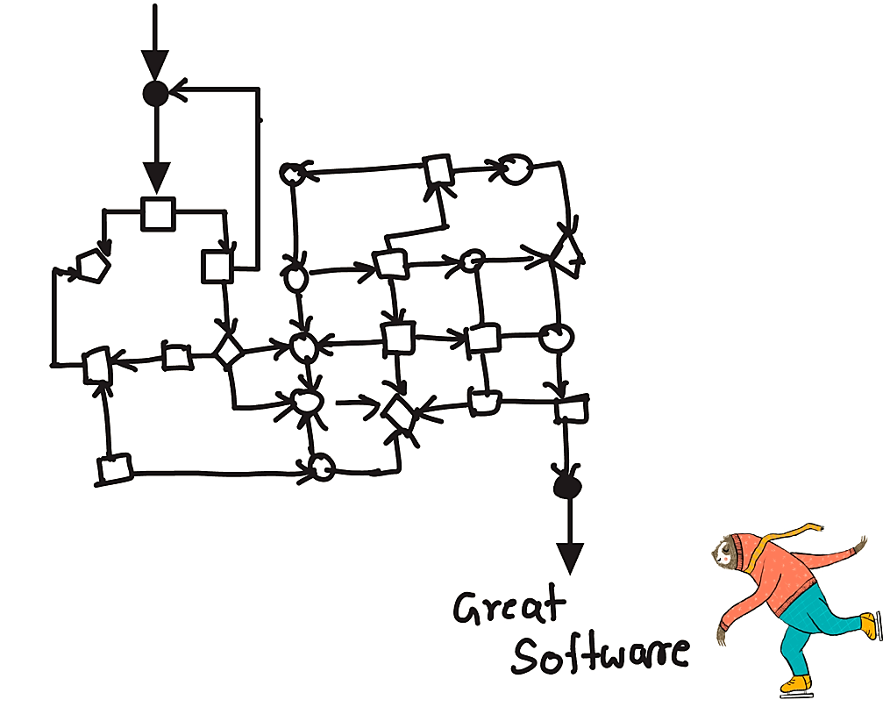
Software Requirement

Slide 14
Dev Fundamentals: Software Development Lifecycle (SDLC)

Slide 15
We Trying to Accomplish ?
Understand what is SDLC
Describe the process of requirements gathering.
Understand two common & most popularly used SDLC models

Slide 16

CIRCLE of Life
Teams come, operate, evolve and disband
People come, grow, and eventually move on
Projects come, grow, evolve and enter stasis
Your project has to accommodate these facts of project lifecycle.

Slide 17
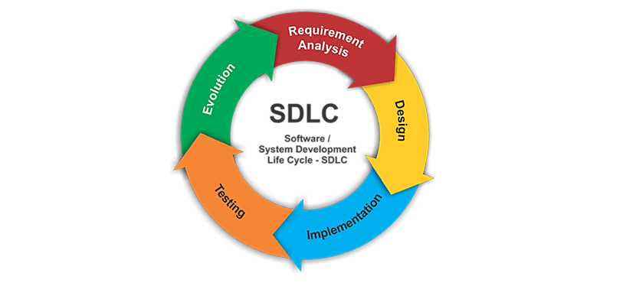
Software Development Life Cycle (SDLC): Why?
Purpose
Leads to good software
Reduces risk
Enables visibility and measurement
Enables team teaming
Key attributes
Outcomes of processes are key deliverables or products
Roles are clear
Pre- and post-conditions are understood and held true

Slide 18
SDLC Key Elements
1. Feasibility
2. Specification
3. Architecture and Design
4. Development
5. Validation
6. Maintenance
7. Evolution
The devil is in the details of how the steps are organized and executed

Slide 19

The Promise and the Reality
Nothing is ever as simple as it seems

Slide 20
SDLC: Process Models
There are various software development life cycle models defined which are designed to organize software development process.
Waterfall
Iterative
Agile
Rapid Application Development (RAD)

Slide 21
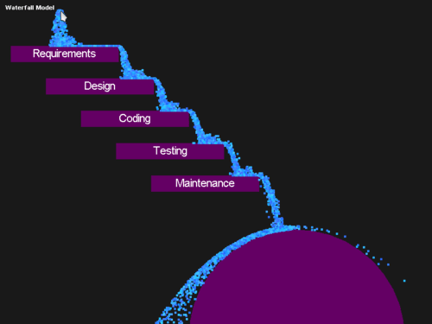
SDLC: Waterfall Model
Waterfall
Follows a step-by-step sequential process where each step waits on the previous one
Design and develop all features of an application in one go.

Slide 22
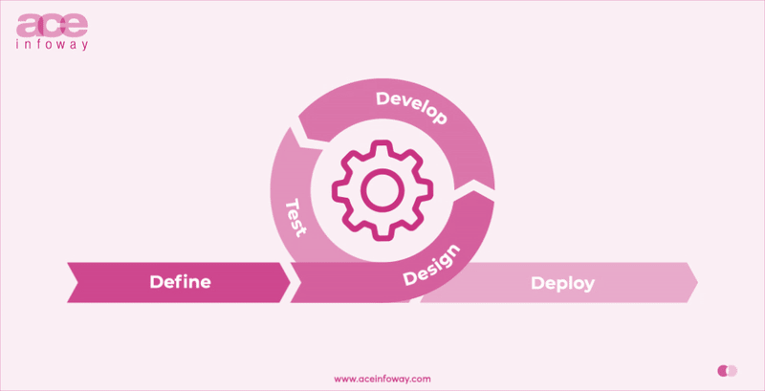
SDLC: Agile Model
Agile
Built to adapt to changes
Getting to MVP is the first goal
Relies on quick and tight feedback loops
Experimentation is good, as long as we measure the results
Highly analytical

Slide 23

More Perspective
more rules to follow
SDLC: Agile Umbrella
RUP(120+)
RUP has over 30 roles, over 20 activities, and over 70 artifacts.
XP(13)
Agile
Scrum(9)
Scrum
XP
DSDM
Kanban(3)
Crystal
Kanban
Agile
Do Whatever!!(0)
RUP
More Adaptive
fewer rules to follow
source https://clutch.co/

Slide 24

SCRUM
In rugby, a scrum is how you restart the game after a minor infraction like a goal or timeout..

Slide 25
Agile Scrum
Emphasis on small, semi-independent teams ideally delivering discrete pieces of a system.
Team ideally has total responsibility for the components it produces.
Leads to DevOps model
1. Team
• Small, cross-functional, self-organizing units
2. Scope
• Small deliverable scope delivered in consensus priority order
• Priorities can be adjusted (typically at sprint start)
3. Timeline
• Small iterations (2-3 weeks is typical) emphasizing delivery at the end

Slide 26
SDLC: Agile vs Waterfall
Agile is a continuous iteration of development and testing in the software development process.
Agile methodology is known for its flexibility
Agile follows an incremental approach
Agile performs testing concurrently with software development
Agile allows changes in project development requirement
Test plan is reviewed after each sprint
Waterfall is a Linear or Sequential Life Cycle Model
Waterfall is a highly structured software development methodology
In Waterfall methodology testing comes after the “Build” phase.
Waterfall has no scope of changing the requirements once the project development starts.
The test plan is rarely reviewed during the test phase.

Slide 27
What is agile ?
The simple definition of agile is step-by-step. Take something big, and break the most urgent thing into smaller pieces. By taking small steps you can see clearly if you're doing the right thing. If not, you can adjust course.

Slide 28
What is agile ?
A way of getting things done
An empirical method to project management
Continuously develop the plan , process and product
A mindset

Slide 29



Why agile ?
Effectiveness
Empower the Team
Manage Complexity
Perform better than traditional projects
Leverage team knowledge and increase job satisfaction
Simple project management approach to increasing complexity

Slide 30

Diving into Agile Methodologies
Agile as an approach for projects is all about ensuring what is being built is valuable.
“Who knows” ? about a project that never been able to add value to a customer ?
THAT’S WHERE BA’s COME IN

Slide 31

Agile Manifesto
https://github.com/dataarjun/Training_Contents/blob/main/Excercise/The_Agile_Manifesto.pdf

Slide 32






Agile Tools

Slide 33
What is Jira ?
JIRA is
• A virtual work planning and delivery tool
• Customizable for your company and project needs
• Provides transparency and real-time reporting

Slide 34
What can JIRA do for you?
JIRA can help you manage your projects
• Coordinate efforts to deliver a product
• Manage and hold all your projects in one location
• Track and organize enterprise-wide initiatives
• Follow team activity with real-time reporting
• Monitor single or multiple projects
• Provide visibility and transparency

Slide 35
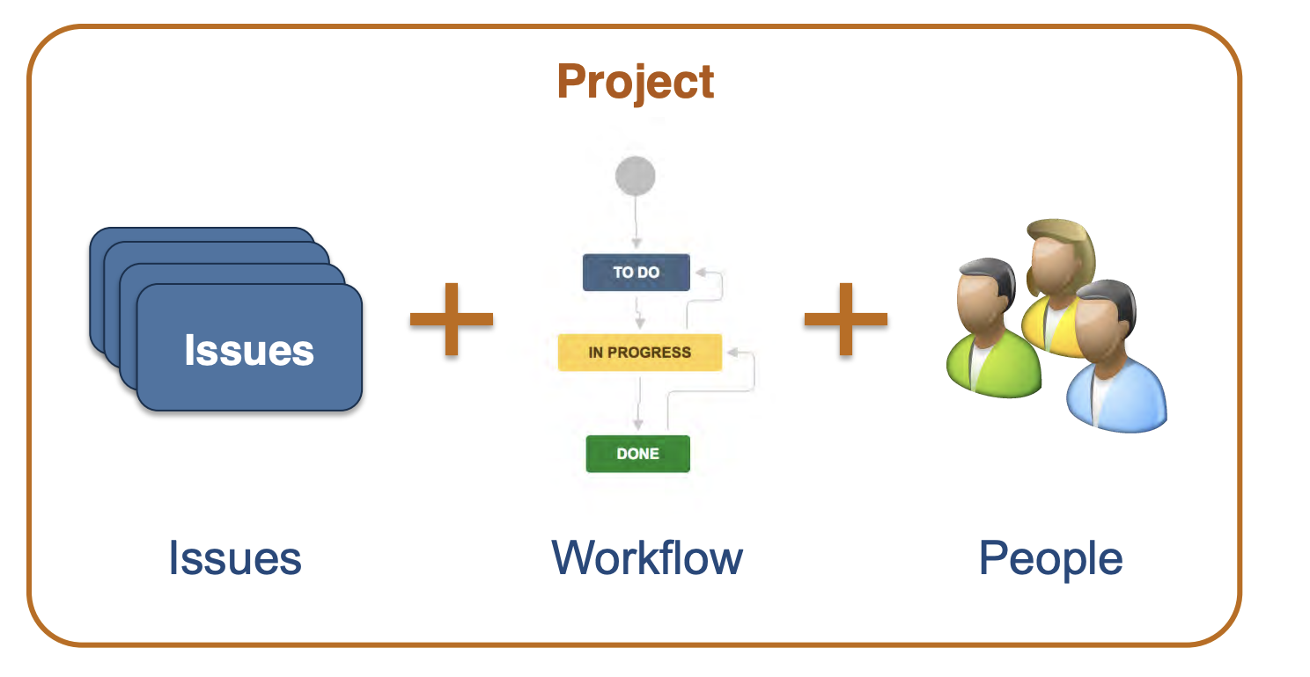
JIRA Projects

Slide 36
What is an Issue ?
Issues are the JIRA term for a requirements
• Story
• Defect
• Improvement
• Request
• Epic
• Task
• Almost anything we want!
• These are the basic elements of JIRA and they follow a predefined hierarchy
• Each Issue has specific fields that hold it’s details and attributes

Slide 37
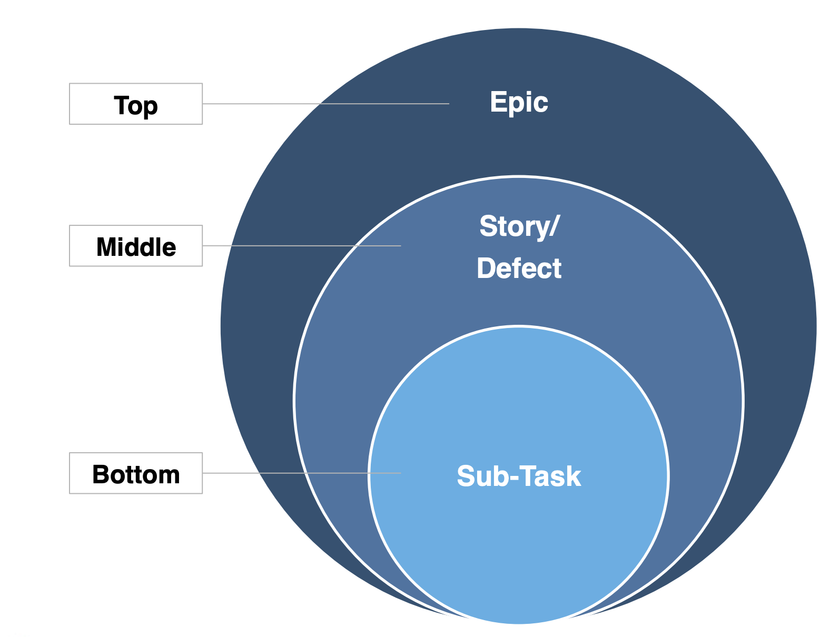
JIRA Standard Issue Type Hierarchy

Slide 38
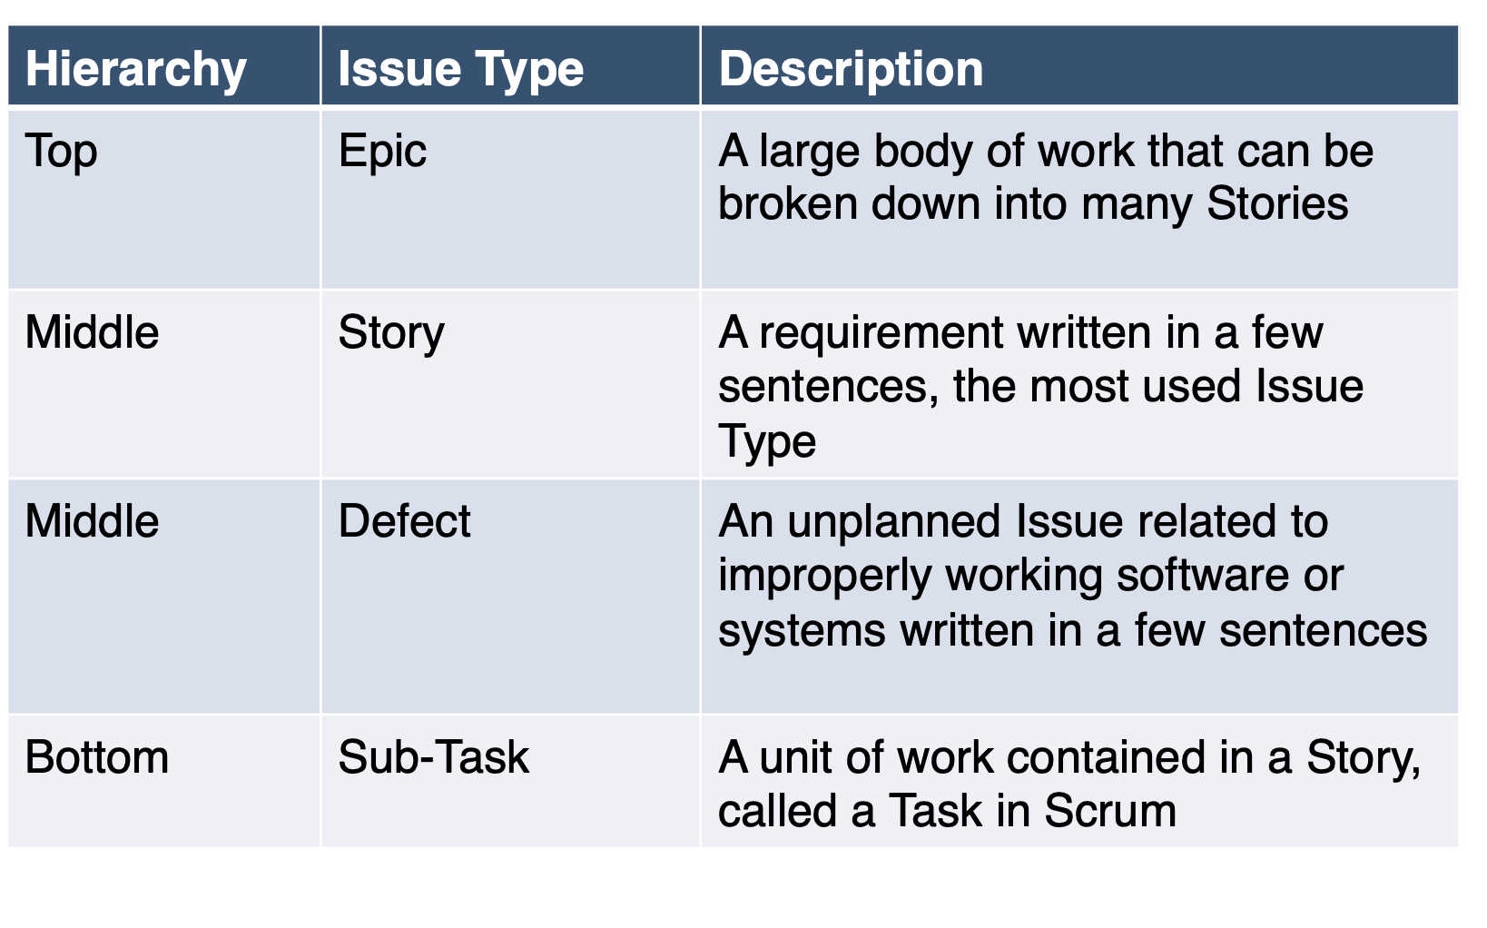
Common JIRA Agile Issue Types

Slide 39
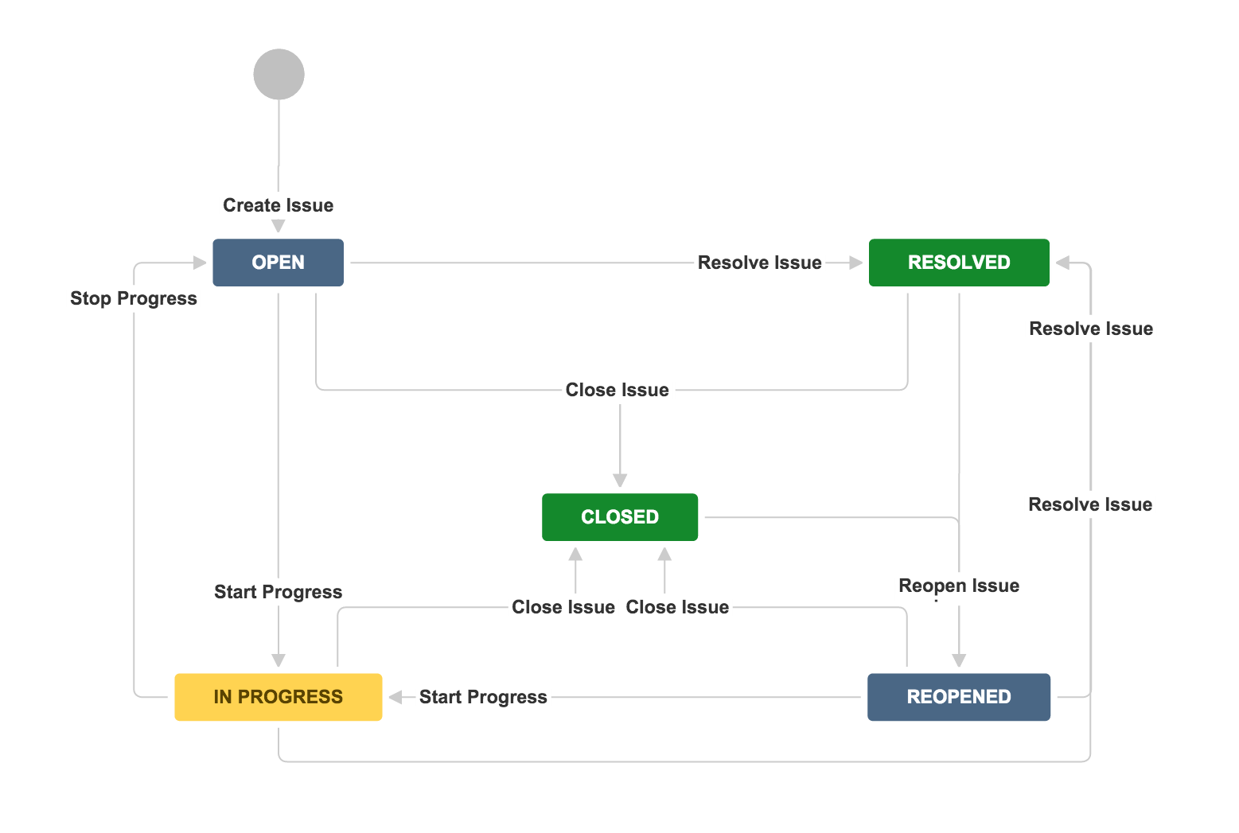
JIRA Workflows
JIRA uses a workflow to manage Issue delivery
• Issues must follow the workflow states
• Customizable for each Issue Type
• Applied to projects and issue types by Project Admin

Slide 40
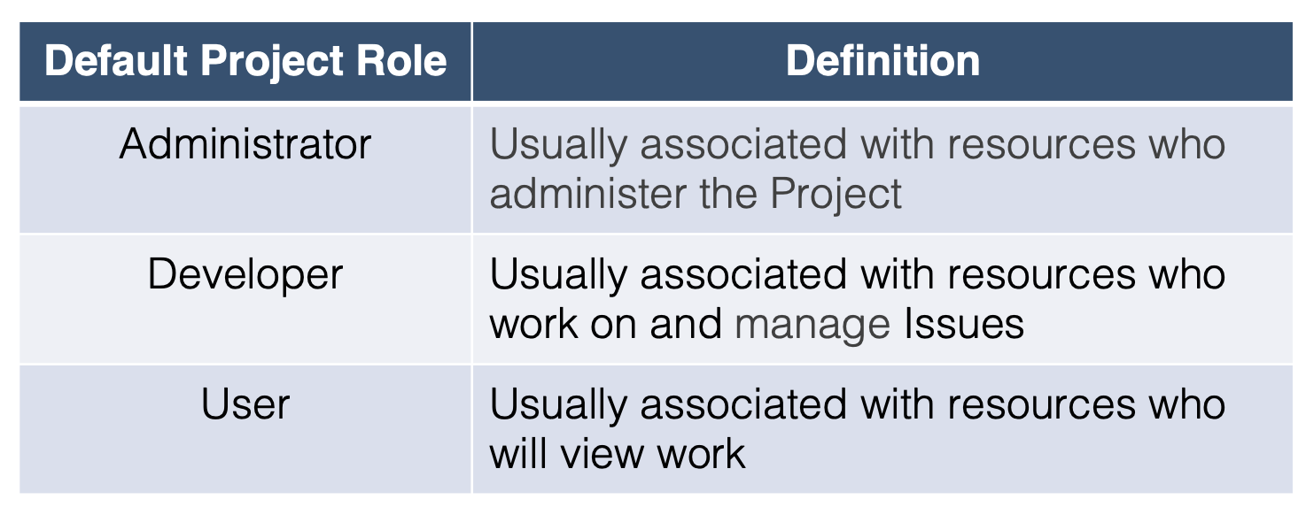
Project Roles
Project roles are a flexible way to associate users and groups with a particular project
Used in conjunction with Permission Schemes to define access and activity permissions to your project

Slide 41
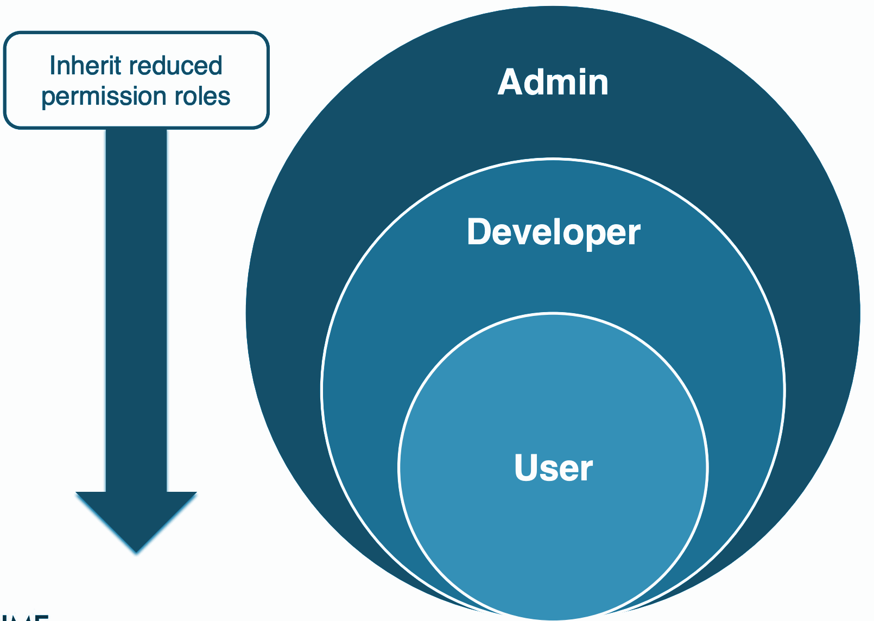
Project Roles

Slide 42

Demo

Slide 43

Exercise
Using JIRA Atlassian https://www.atlassian.com, add the user stories as a storyboard based on the case study given in the earlier exercise.

Slide 44
Dev Fundamentals: Git Basics

Slide 45
What are we going to learn?
What makes Git special ?
Git and the basics of Git
What is version control ?
Popular Git-based services

Slide 46

What is Git?
Git is a Version Control System (VCS) designed to make it easier to have multiple versions of a code base, sometimes across multiple developers or teams. ( It is not same as GitHub )

Slide 47

Then what is Github?
Github.com is a website that hosts git repositories on a remote server

Slide 48
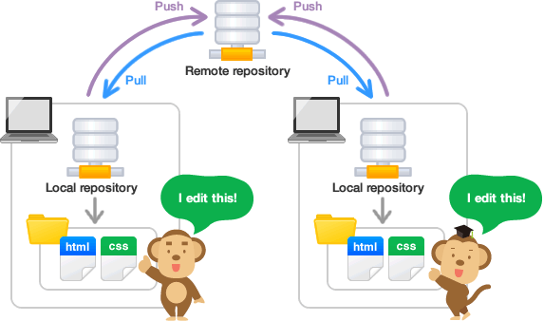
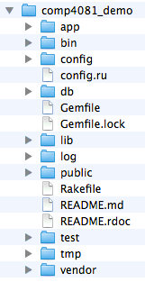
How GitHub works?
GitHub
By pushing your repositories to Github, you will pretty much automatically create your own developer portfolio as well!

Slide 49



Some popular Git Hosting Services
Here the three most popular Git hosting services:
GitHub: Owned recently by Microsoft — Launched in 2008 (31 million users in October 2018).
GitLab: Owned by GitLab Inc. — Launched in 2011.
BitBucket: Owned by Atlassian — Launched in June 2008.

Slide 50

Confirm that you have git
VS Code
Open your vs code terminal and run ‘git’
If you see a ‘command not recognized’ error, you probably haven’t installed git yet.
We can solve your issue once we start the lab session – sit tight for now!

Slide 51
Basic Git Commands
command description | command description
git clone url [dir] | copy a Git repository so you can add to it
git add file | adds file contents to the staging area
git commit | records a snapshot of the staging area
git status | view the status of your files in the working directory and staging area
git diff | shows diff of what is staged and what is modified but unstaged
git help [command] | get help info about a particular command
git pull | fetch from a remote repo and try to merge into the current branch
git push | push your new branches and data to a remote repository
others:init,reset,branch,checkout,merge,log,tag

Slide 52
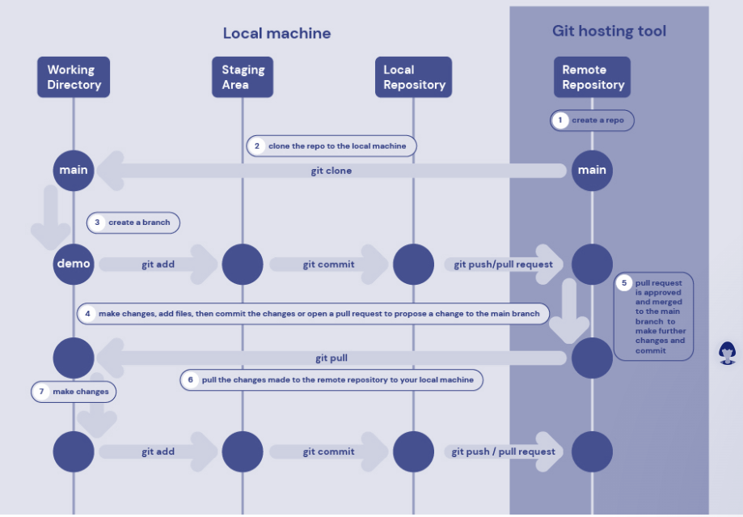
Git Workflows
Image source: https://www.hostinger.com/

Slide 53
Initialize Git
Initializing an empty git repository.
git init # Initialize an empty git repository under current directory.
Cloning a repository
git clone https://github.com/UTXXXYZ/git-test.git # Clone this repository to your current working directory

Slide 54
Commit Files
Make a commit
git commit # Make a new commit with the changes in your staging area. This will open an editor for a commit message.
git commit -m "I love documentation" # Make a new commit with a commit message from the command line
git commit -a # Make a new commit and automatically "add" changes from all known files git commit -am "I still do!"
A combination of the above
git commit --amend # Re-do the commit message of the previous commit (don't do this after pushing!)
We never change "public history“
git reset <file> # Unstage a staged file leaving in working directory without losing any changes.
git reset --soft [commit_hash] # resets the current branch to <commit>. Does not touch the staging area or the working tree at all.

Slide 55
Remote Git
Working with Remotes
git remote # Show your current remotes
git remote -v # Show your current remotes and their URLs
git push # Publish your commits to the upstream master of your currently checked out branch
git push -u origin my-branch # Push newly created branch to remote repo setting up to track remote branch from origin.
No need to specify remote branch name, for e.g., when doing a 'git pull' on that branch.
git pull # Pull changes from the remote to your currently checked out branch

Slide 56
Dev Fundamentals: The Anatomy of a Full Stack App

Slide 57
What are we going to learn?
What’s Full Stack Development?
Full Stack technologies & Frameworks
Hosting and Infrastructure

Slide 58
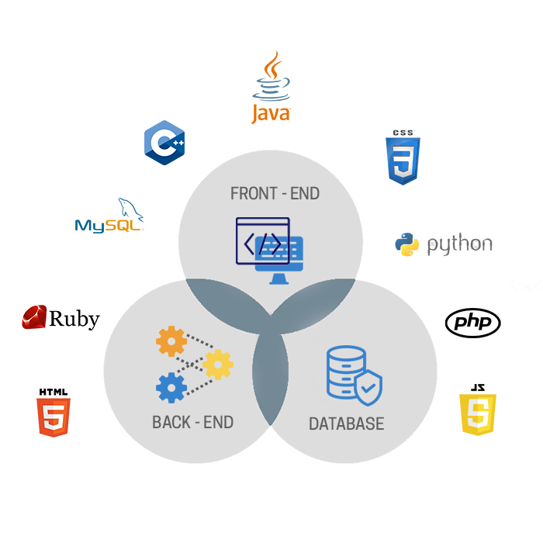
What is Full Stack Development
Notes:
A full stack web developer is a person who can develop both client and server software.

Slide 59
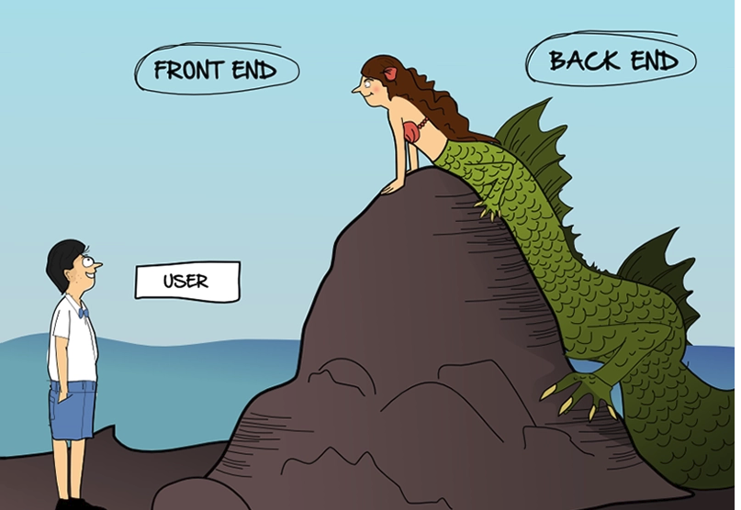
Who is a Full Stack Developer?
A full stack web developer is a person who can develop both frontend and backend software.
Notes:
A full stack web developer is a person who can develop both client and server software.

Slide 60
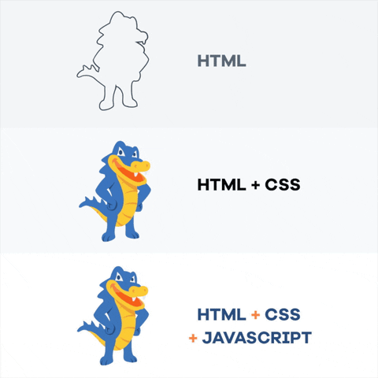
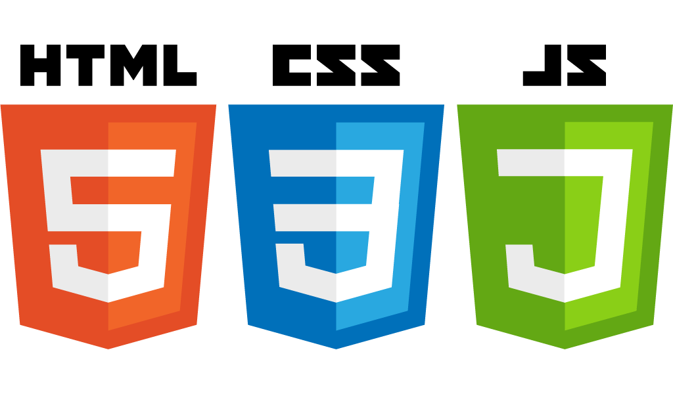

Front End Development Languages

Slide 61
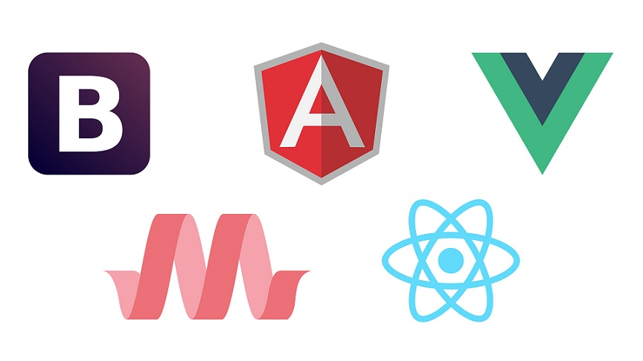
Front End Development Frameworks
Bootstrap
Angular
Vue.js
Materialize
React.js

Slide 62
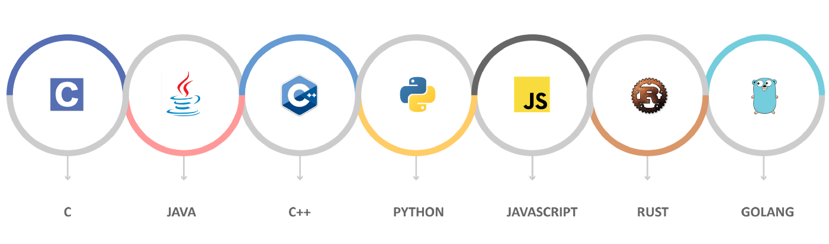
Back End Development Languages

Slide 63
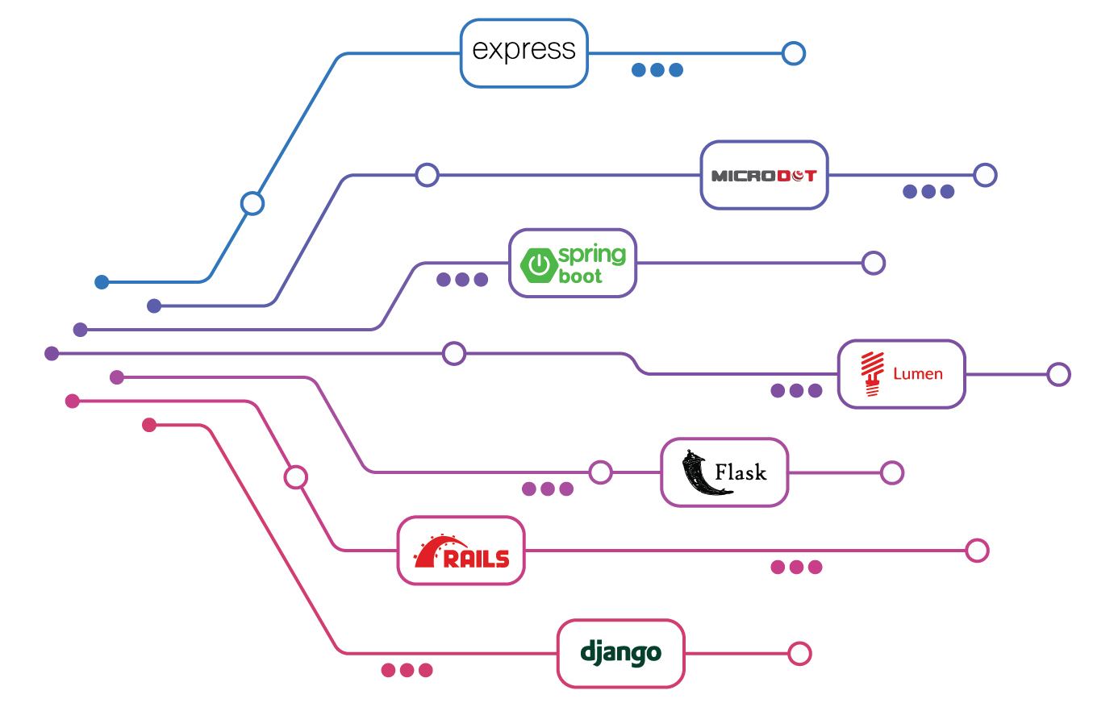
Back End Development Frameworks

Slide 64
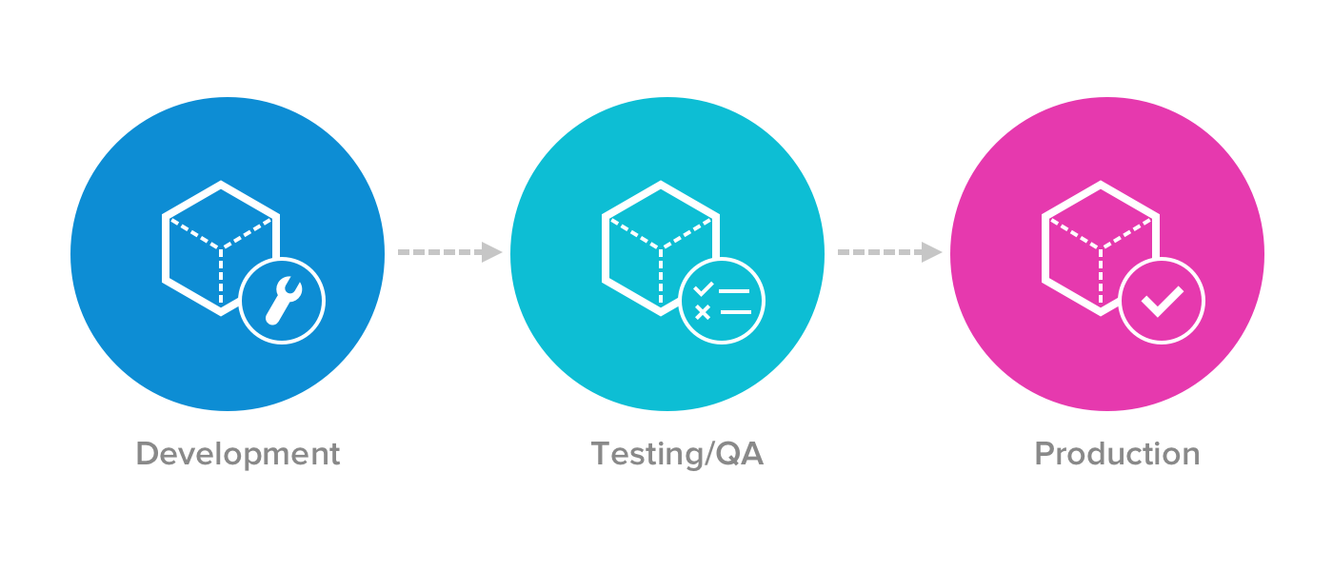
Software Deployment

Slide 65
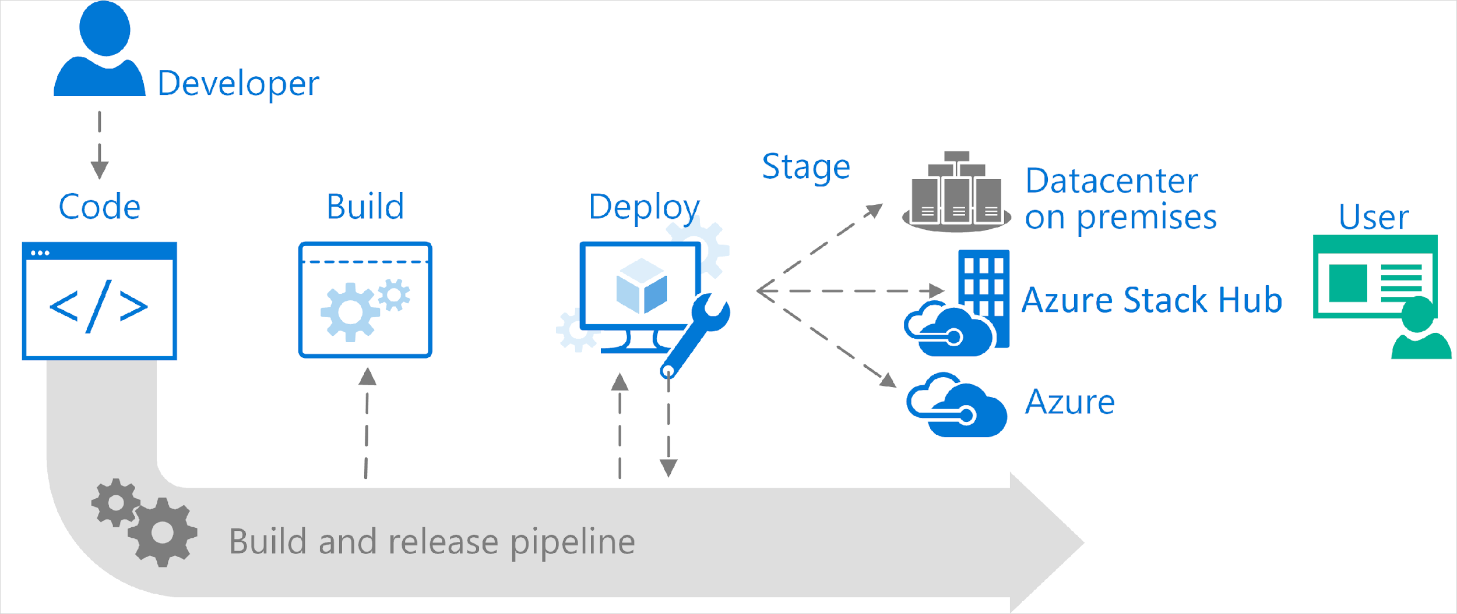
Software Hosting & Deployment
Cloud Dev Server
Cloud Prod Server

Slide 66
Full-stack Business Analyst
Instead of a technology stack, the Full-Stack Business Analyst focuses on the Product Stack, which is comprised of:
Ideation: Discovering possible opportunities
Validation: Ensuring that this is a good/the right opportunity
Visioning: Creating a shared understanding and leading through development of a compelling vision
Decomposition: Breaking the vision into smaller achievable chunks and identifying experiments to test and learn
Delivery: Building the solution and getting those solutions into the hands of our customers
Monitoring: Analyzing metrics to validate success and identify new opportunities

Slide 67
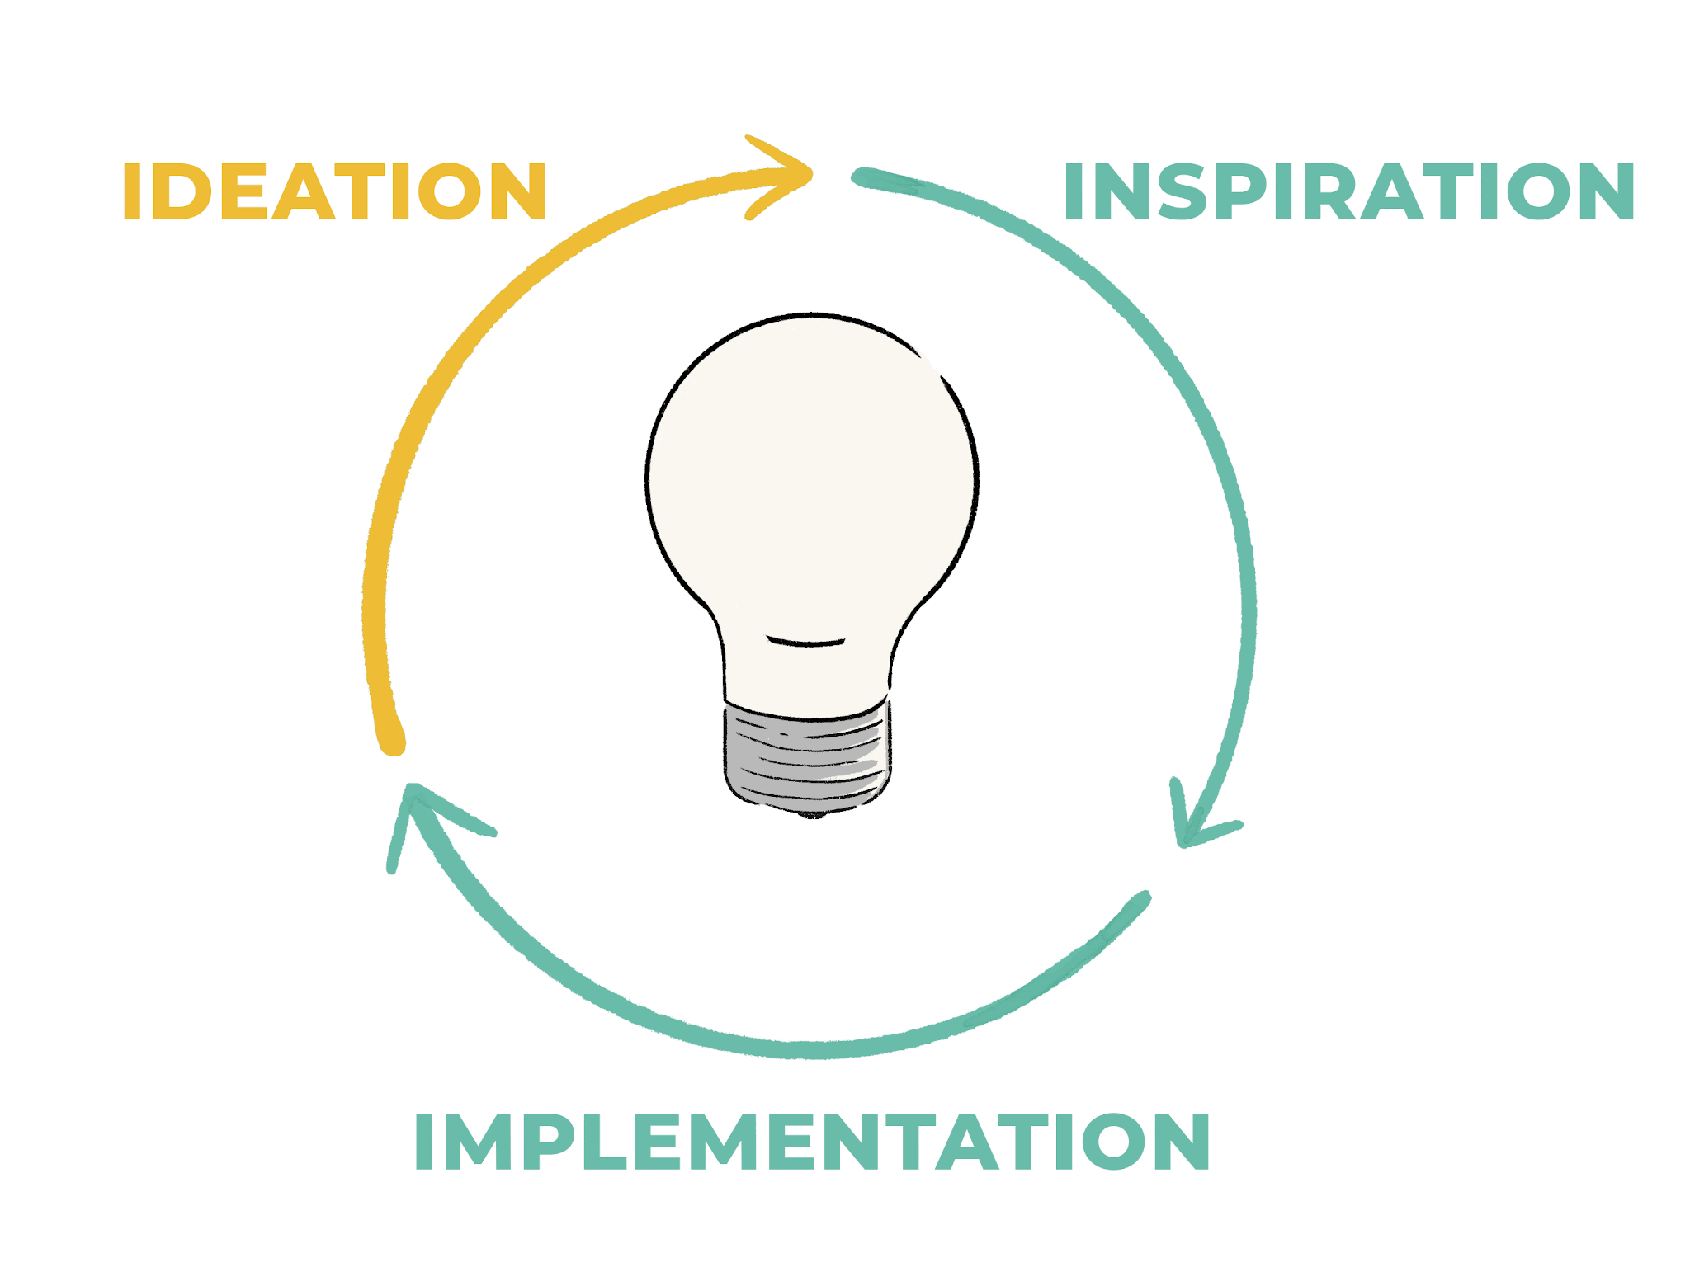
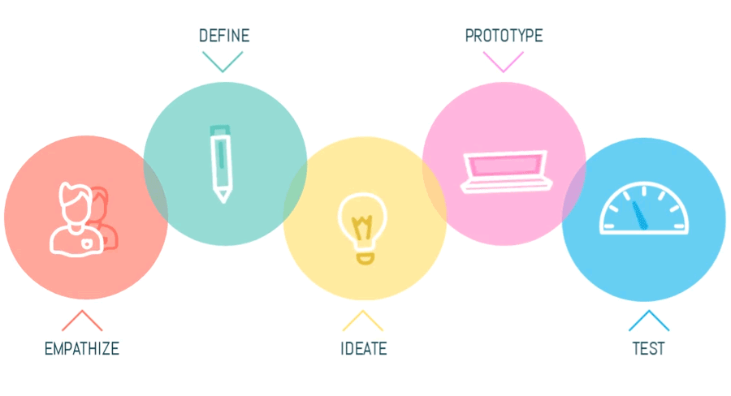
Ideation: Discovering Opportunities
Ideation is where you use data, your knowledge of the business environment, knowledge of your organization’s capabilities, and your understanding of your customers to discover ideas for potential solutions.
Skills and knowledge needed for ideation include problem analysis and identification of opportunities through Design Thinking or Lean Startup and tools like personas, empathy maps, customer journeys, and experiments.

Slide 68


Validation: Confirming it’s the Right Opportunity
Validation occurs when you analyze your idea to make sure there’s good problem/solution fit as well as good product/market fit.
You’ll likely develop a business case as part of the validation to ensure that the product idea is worth the investment and to help with prioritization.

Slide 69

Visioning: Gaining Buy-In & Alignment
Once you have validated the product idea, you’ll need buy-in from your organization to get the time, money, and other resources you need to make the idea come to life.
This involves influencing, using data from your earlier validation, creating a compelling vision, and creating alignment by developing a shared understanding of the problem, proposed solution, metrics, and expected outcomes.

Slide 70

Decomposition: Making work Manageable
Even if you have a great product idea and alignment in your organization, it’s difficult to understand and deliver the solution in one big piece. We need to break the work down into smaller, more manageable pieces.
When you decompose work, you’ll likely identify the Minimum Viable Product (MVP) and Minimum Marketable Features (MMF). You can also use techniques such as Story Mapping to create a holistic view of the initiative as well as thin slices to deliver.

Slide 71

Delivery: Getting the right solution to Customer
Once you have alignment and an understanding of how the product can be delivered, it’s time to build the solution. Whether you’re developing in iterations or a big bang implementation, you’ll want to create fast feedback loops and adjust your approach along the way.
The other component beyond building the solution and testing it is getting the product into the hands of customers. Knowledge about how your organization delivers products will help you provide more value and reduce delays. This may mean learning about DevOps practices.

Slide 72

Monitoring: Metrics for Success
Just because you successfully deliver the product, your job as a Full-Stack Business Analyst isn’t done. How do you know if you achieved the intended outcome?
You need to be able to monitor the product, its usage, and metrics. Doing so allows you to validate your original hypothesis and helps you to discover new opportunities.

Slide 73

DFD: Data Flow Diagrams
A Data Flow Diagram ( DFD) is a graphical representation of the flow of data through a computer system.
OR
A Data Flow Diagram looks at how data flows through a system.
It concerns things like where the data will come from and go to as well as where it will be stored.

Slide 74
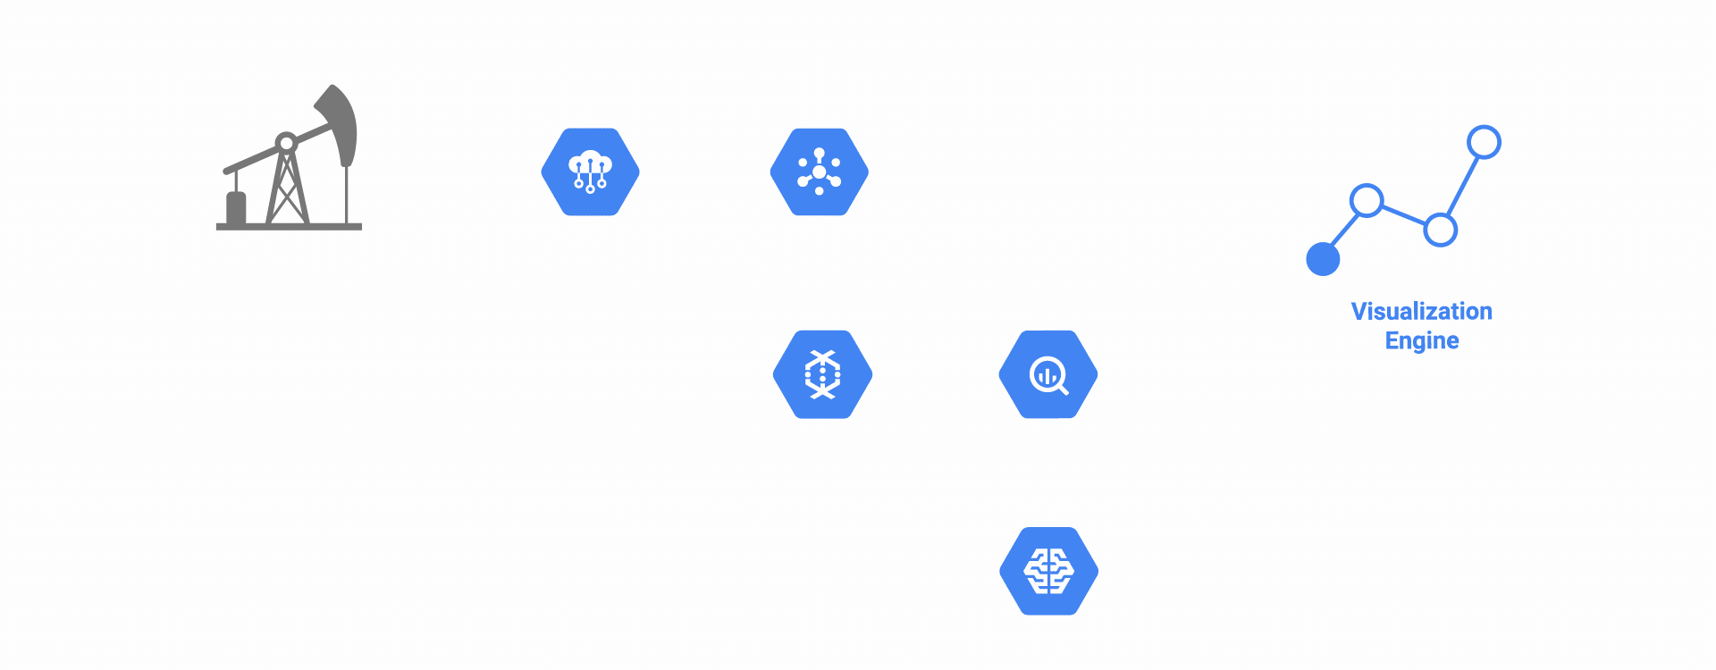
DFD is not a Flow Chart
Sometimes people get confused between data flow diagram and flowchart.
The flowchart illustrates flow of control in program modules.
Data flow diagrams illustrate flow of data in the system at various levels.
Data flow diagram does not have any control or branch elements.

Slide 75
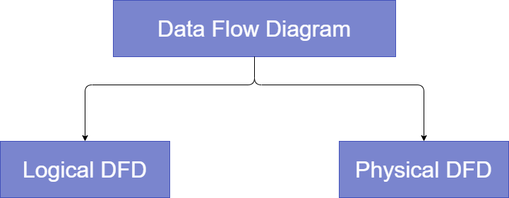
Types of DFD
DFD if of two types

Slide 76
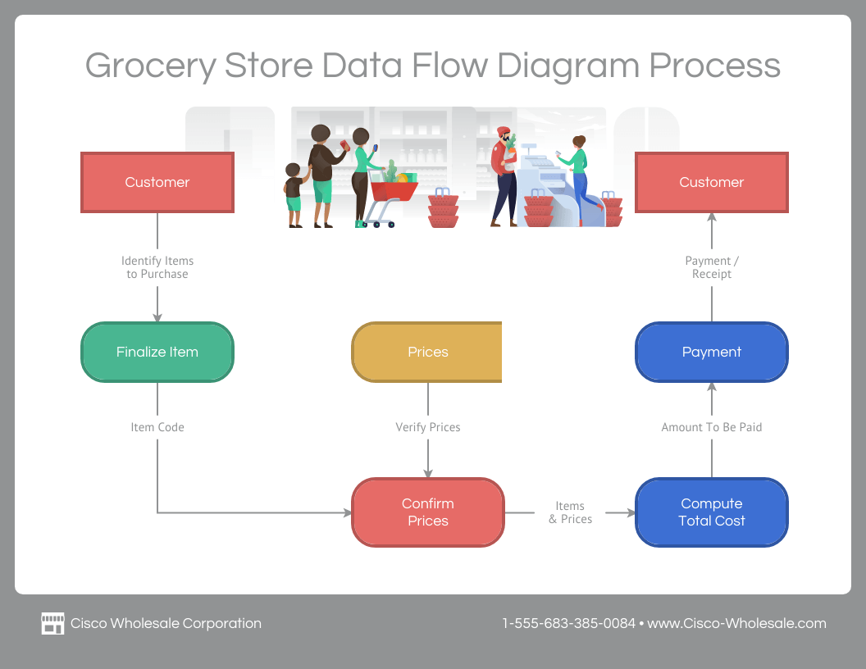
Logical DFD
Logical DFD: A logical DFD shows the conceptual flow of information through a process, focusing on the kind of data needed, its source, destination, and the transformation desired from the process. Here’s an example.

Slide 77
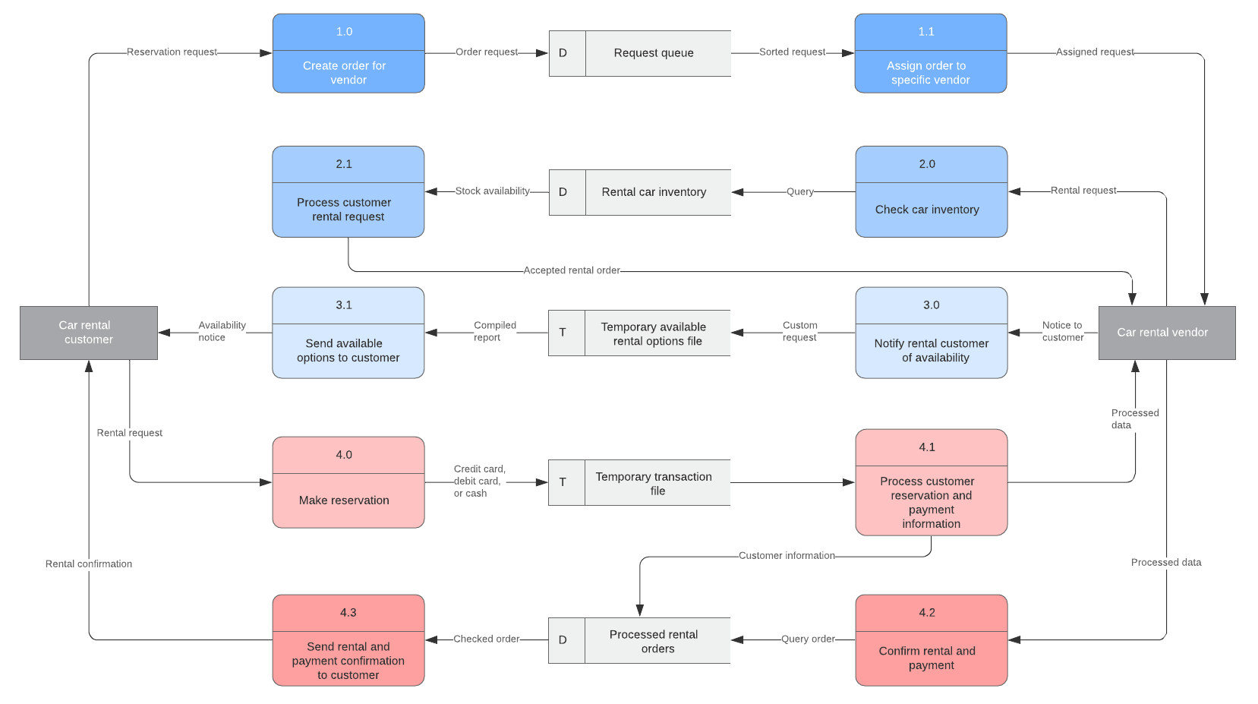
Physical DFD
Physical DFD: On the other hand, a physical DFD visualizes how the system plan will be executed, including the specific tools, hardware, or players needed to make it work. Just like this example.

Slide 78
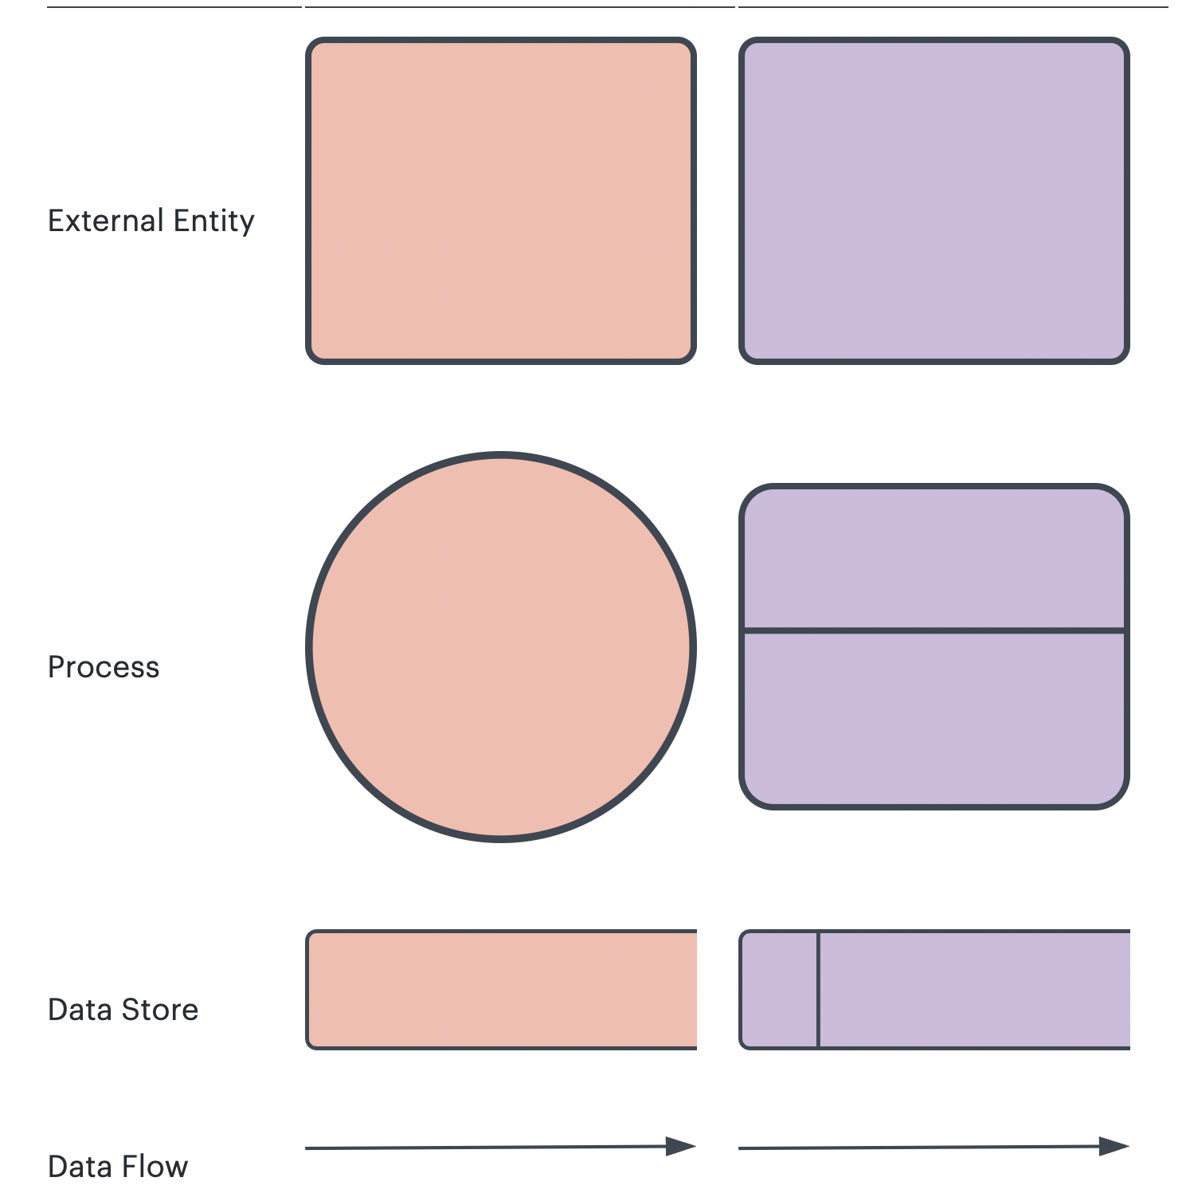
DFD Symbols
Notation | Yourdon and Coad | Gane and Sarson

Slide 79
Exercise
Create a simple high level data flow diagram that depicts the frontend and backend processes for the Online Pizza Delivery shop.
Example DFD in Lucid Chart

Slide 80
Dev Fundamentals: CI/CD & DevOps

Slide 81
Why DevOps ?
Are you troubled by the strange ways your organization delivers software ?
Do you experience feelings of dread when preparing long painful application release?
Have you or your co-worker experienced buggy , unstable services after deployment?
Does it take day, weeks or months to build and deploy a application ?
If your answer is YES
You need DevOps

Slide 82
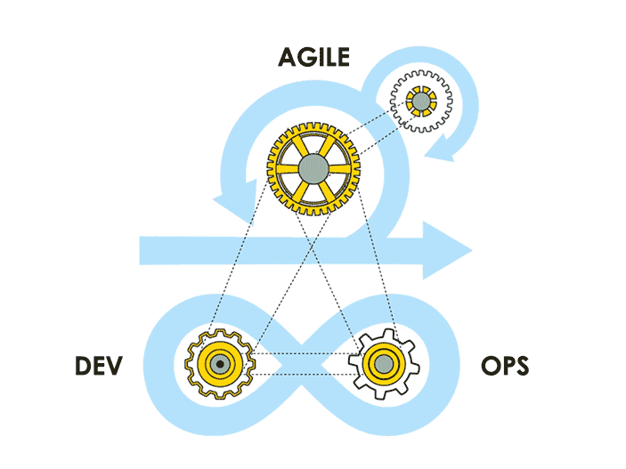
What are we going to learn?
Devops Fundamentals
CI/CD
Automated builds, testing and deploying code

Slide 83
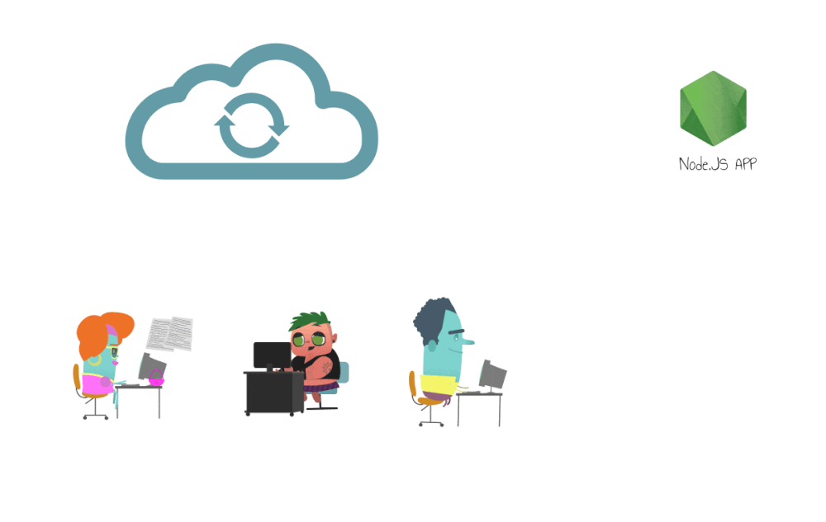
Continuous Integration
Continuous Integration (CI) is a DevOps software development practice that enables the developers to merge their code changes in the central repository. That way, automated builds and tests can be run.

Slide 84
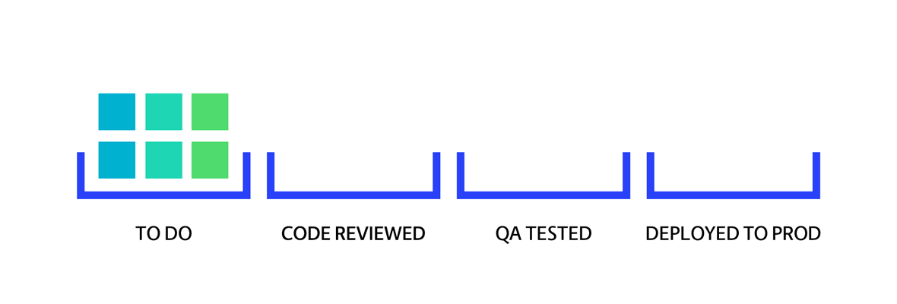
Continuous Deployment
Continuous Delivery (CD) is a DevOps practice that refers to the building, testing, and delivering improvements to the software code. The phase is referred to as the extension of the Continuous Integration phase to make sure that new changes can be released to the customers quickly in a substantial manner.

Slide 85
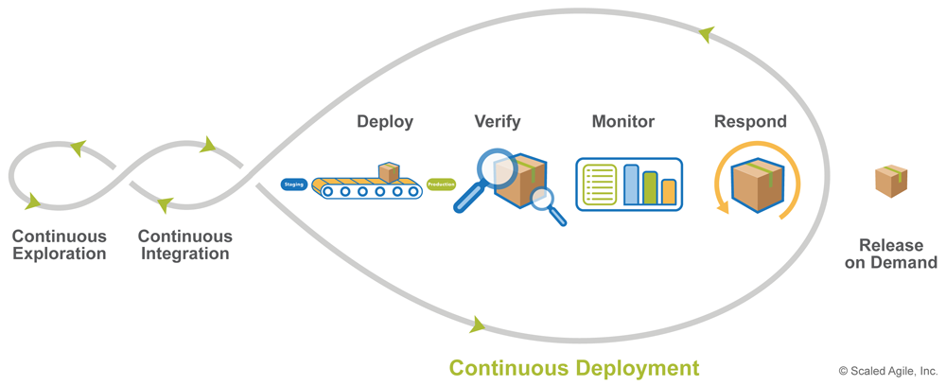
CI/CD
Source: https://puppetlabs.com/

Slide 86


The Devops Story
Traditional Development and Operations
OPS
DEV

Slide 87

It’s DevOps!
“DevOps is treating your infrastructure as code”
“DevOps is development and operations collaboration”
It’s DevOps!
“DevOps is using automation”
It’s DevOps!
“DevOps is feature switches”
It’s DevOps!
“DevOps is small deployments”

Slide 88






DevOps: the three stage conversation
OPS
DEV
1
People
2
Process
3
Products

Slide 89

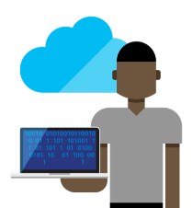



The consequences of inefficiency
41
%
… of development budgets for software, IT staff and external professional services will be consumed by poor requirements
Business
IT Ops
Developers
3/4
1 in
6
The average hourly cost of infrastructure failure is $100,000 per hour
of teams
IT decision makers is still unfamiliar with the term DevOps
DevOps was being initiated by more development teams than IT Ops teams by about a 40% to 33% margin
have adopted
Agile methodologies

Slide 90
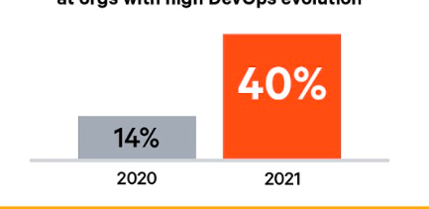
Devops Benefits
Deploy code 30x faster
Strong IT Performance is a competitive advantage
and with 200x shorter lead time as compared to your lower-performing peers
Firms with high-performing IT teams were 2x as likely to exceed their profitability, market share, and productivity goals
Have 60x fewer failures
DevOps practices improve IT performance
and recover from failure 168x faster as compared to lower-performing peers
Source: www.devopsdigest.com

Slide 91
200 level Practices
300 level Product w/ Practice
DevOps Framework
Infrastructure as Code
Azure Deployment Template with Azure Website + SQL DB
100 level Overview
Chef Recipe with Linux VM on Azure
People, Process, Business Value, etc.
Continuous Integration
Visual Studio Team Services (git) + Jenkins (build)
Github + Visual Studio Team Services + Gradle

Slide 92
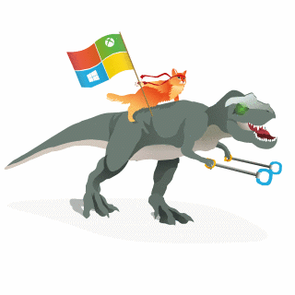



Happy DevOps
DEV
OPS
Production
Inspired by Microsoft

Slide 93
Benefits of DevOps ?
• Empowering teams
• Lowered cycle time (shortens lead times for changes, time to market goes down, lower MTTR)
• Better security (and quality increases, not decreases)
• Rhythm of practice (limits your work in progress)
• More time to be productive

Slide 94
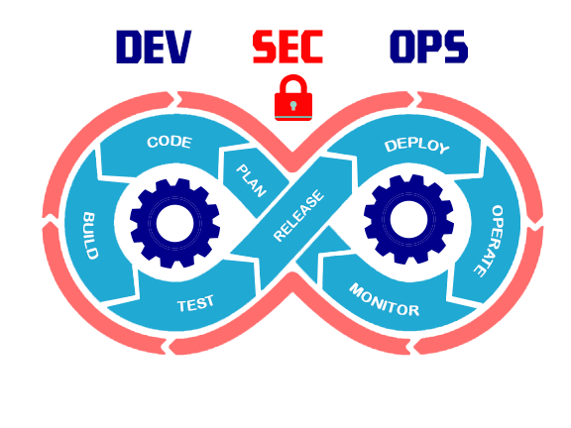
What is DevSecOps
DevSecOps is a set of disciplines combining development, security, and operations.
It is a philosophy that helps software development businesses deliver innovative products quickly without sacrificing security. T
This allows potential security issues to be identified during the development process – and not after the product has been released in line with the emergence of continuous software development practices.

Slide 95
Exercise
Note down the steps in DevOps
Create an application diagram that depicts the end to end flow of the application OnlinePizza store application.

Slide 96
Dev Fundamentals: Testing Methods

Slide 97
Types of Testing
Unit testing
Integration testing
Code hygiene
TDD, BDD, ATDD
Infrastructure testing
Performance testing
Security testing

Slide 98
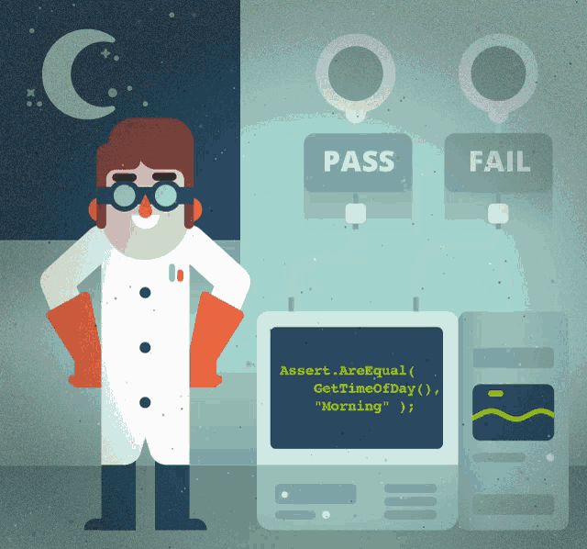
Unit Testing
Unit tests are very low level and close to the source of an application.
Unit testing is performed at build time on a single unit of code and/or artifact without use of external dependencies or deployment

Slide 99
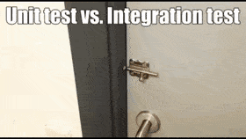
Integration Testing
Integration testing is performed as you bring together pieces of your application and as it needs to use external dependencies—databases—to actually do its thing

Slide 100

TDD Testing
TDD, or test-driven development, is the practice of writing a failing test first, and then writing the code that causes the test to pass, and then refactoring it to make it cleaner

Slide 101
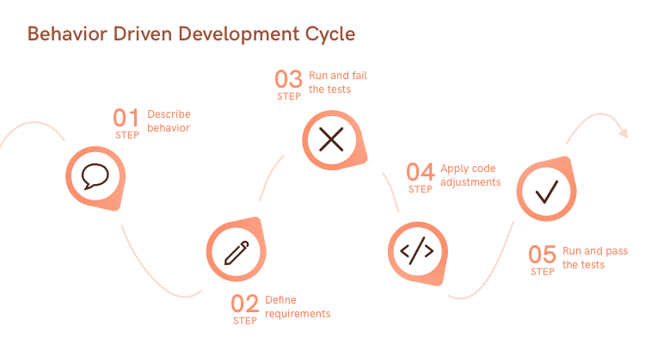
BDD Testing
BDD, or behavior-driven development, is a refinement of TDD that focuses on simple
sentence-driven testing
The scenarios in BDD have several purposes:
Illustration of the requirements
Documentation of the behavior
Automated tests

Slide 102
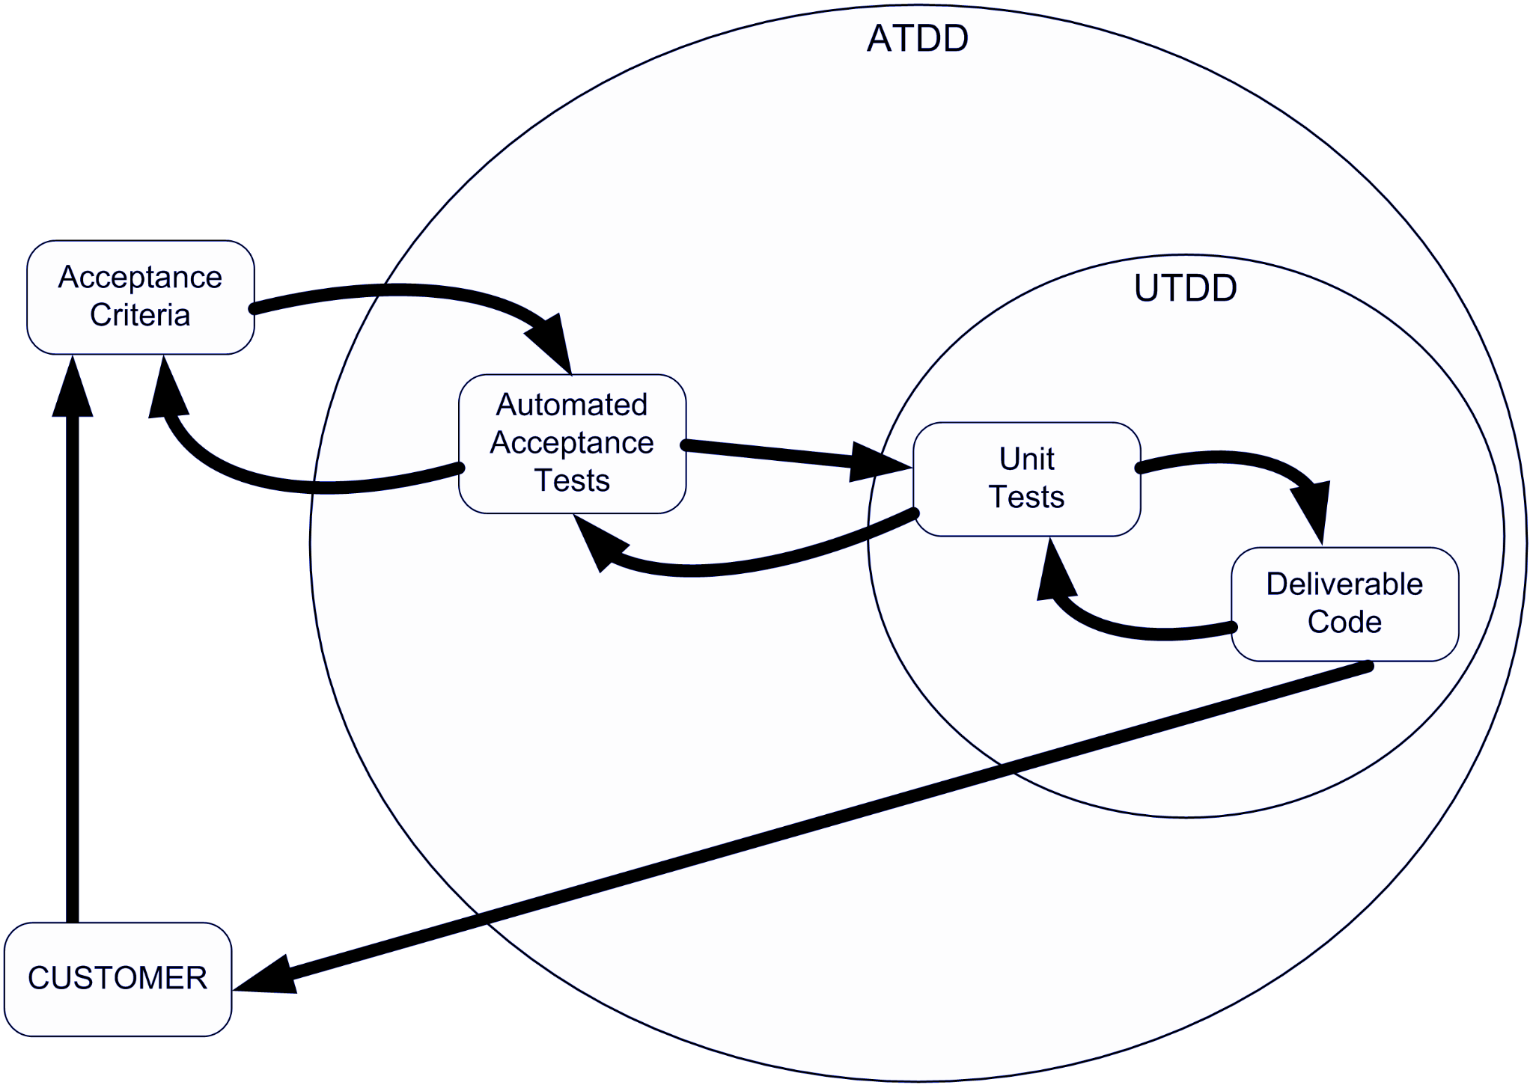
ATDD Testing
ATDD, or acceptance test-driven development, extends this to where the project team decides on a set of BDD acceptance tests before development begins

Slide 103
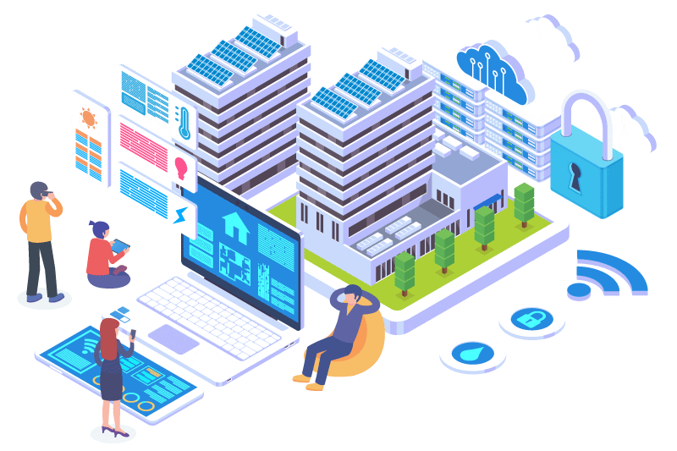
Infrastructure Testing
Infrastructure testing is the testing process that covers hardware, software, and networks, security etc. It involves testing of any code that reads configuration values from different things in the IT framework and compares them to intended results. It reduces the risks of failure.

Slide 104
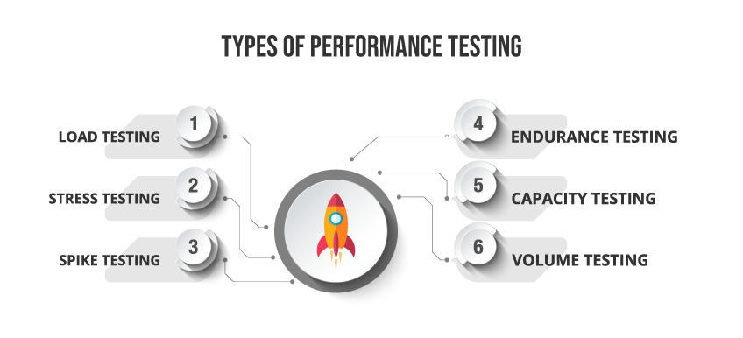
Performance Testing
Performance testing is a non-functional software testing technique that determines how the stability, speed, scalability, and responsiveness of an application holds up under a given workload.

Slide 105
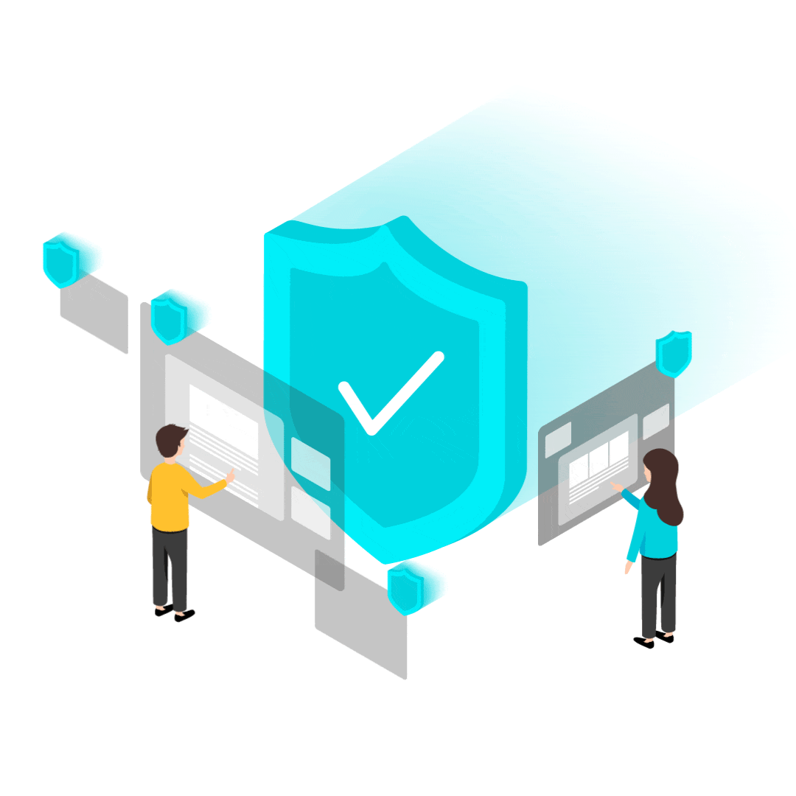
Security Testing
Security Testing is a type of Software Testing that uncovers vulnerabilities of the system and determines that the data and resources of the system are protected from possible intruders.
Below are the six basic principles of security testing:
Confidentiality
Integrity
Authentication
Authorization
Availability
Non-repudiation

Slide 106

Product Demo

Slide 107

Key Takeaways
Fundamentals of SDLC process and Documentation
Version control systems
Devops Fundamentals
CI/CD pipelines
Testing

Slide 108
Quiz
In waterfall model output of one phase is input to next phase.
True
False
Answer: It is True

Slide 109
Quiz
2. Selection of particular life-cycle model is based on ?
Requirements
Technical Knowledge of Development team
Users
Project Types & Associated Risks
All of the above
Answer: E. All of the above . Because it depends on all of this aspects .

Slide 110
Quiz
3. Which of the following is a characteristic of Agile Development?
Repeated Customer Collaboration
Focus on Business Goals
Rapid Application Development
Ans 1 & 2
Ans 1 & 3
Ans 2 & 3
All of the above
Answer: D

Slide 111
Quiz
4. Your new code ends with a broken build. How should you handle this?
Revert to a previous version of the code and fix it in your own time.
Commit the code anyway because the automatic testing will find the problem.
Try to recommit the code to determine whether the issue is in the version control.
None
Answer: A
It is a best practice that developers take responsibility for their own build and do not leave a build broken.

Slide 112
Quiz
5. Why does continuous delivery offer a team more time to be productive?
Teams spend less time doing rework or fixing problems.
It allows teams to implement one feature at a time to ensure each works.
Much of the process is automated, so teams have more time for personal projects.
None
Answer: A
Determining bugs and fixing code is taken care at the DevOps end.

Slide 113
Quiz
6. For the purposes of CI/CD, what are the primary benefits of Unit Tests?
speed of test execution and confidence to ship faster
business stakeholders can write them and run the tests themselves
testing all the edge cases and ability to do build matrixes
testing all the backend services needed and using real traffic
Answer: A
Yep, unit tests are fast to run and increase confidence of your team

Slide 114
Quiz
7. Why is integration testing needed even if we have good unit testing in place?
to see how our application is built
to test external dependencies to our application
to add chaos into our system
understanding how cosmic rays impact our system
Answer: B
Yep, we use integration testing to exercise our dependencies.

Slide 115




Thank you!
Notes:
Mandatory -- Need bookend -- first and last thing they should see is DevelopIntelligence
ACTION: Use this for the final slide of your class materials.

